Slide 1
Materials Management and Climate Change
An Introduction

Slide 2
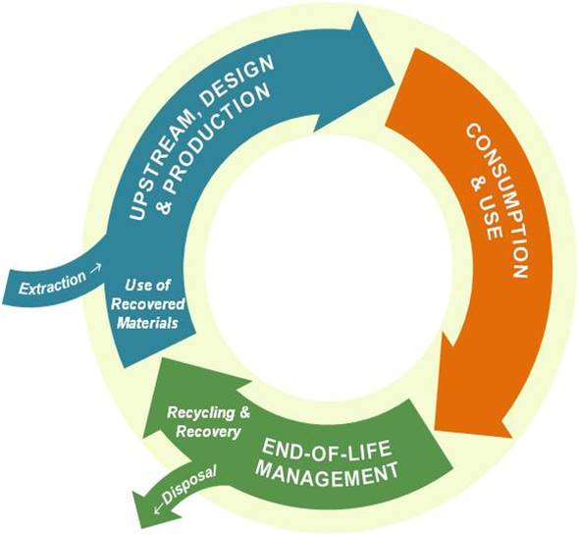
Materials and Greenhouse Gas Emissions
Strategies to reduce material-related greenhouse gases for governments and others
Recycling
Reusing and Reducing
Climate Friendly Purchasing
Consuming Less
3) Climate Action Plans
4) Case Studies
Resource
Overview1

Slide 3
“Materials management is an approach to using and reusing resources most efficiently and sustainably throughout their lifecycles. It seeks to minimize materials used and all associated environmental impacts.”
From EPA, Opportunities to Reduce Greenhouse Gas Emissions through Materials and Land Management Practices (PDF) (98pp, 1.5MB)
Materials Management: A Working Definition1

Slide 4
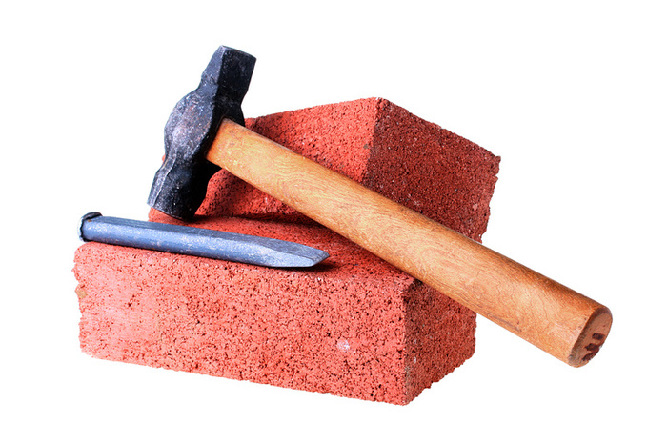
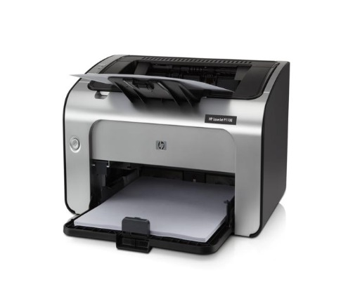
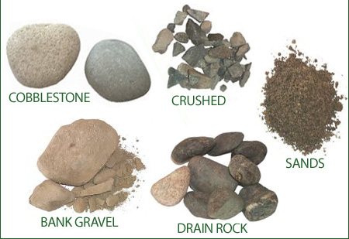
Define “materials” ”

Slide 5
Global Material Consumption and Carbon Emissions
Global Financial Crisis
Recession
Oil Crisis
World War II
Great Depression
World War I
Materials Consumption and Carbon Emissions

Slide 6
Source: U.S. Inventory of GHG Emissions and Sinks : 1990-2006 (US EPA, 2008)
U.S. Greenhouse Gas Emissions (2006))

Slide 7
Source: U.S. Inventory of GHG Emissions and Sinks : 1990-2006 (US EPA, 2008)
US Greenhouse Gas Emissions (2006) )

Slide 8
Materials Management
42%
Source: Opportunities to Reduce Greenhouse Gas Emissions through Materials and Land Management Practices. U.S. EPA.
US Greenhouse Gas Emissions (2006) )

Slide 9
Source: Opportunities to Reduce Greenhouse Gas Emissions through Materials and Land Management Practices. U.S. EPA
Materials: Production Dominates Emissions1

Slide 10
END-OF-LIFE Management vs. MATERIALS Management
Disposal
Resource
Material Lifecycle 1

Slide 11
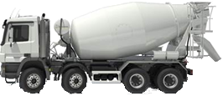
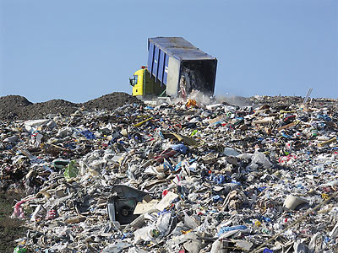
Resource
Extraction
Processing
Manufacturing
Recycling or Disposal
Distribution
Landfill
Use
Lifecycle of Concrete 1

Slide 12
Ways to reduce material-related greenhouse gases for governments and others
Recycling
Reusing Products
Reducing Material Use
Reducing Wasted Food
Reducing Building Materials
Climate Friendly Purchasing
Changing Consumption Behaviors
Resource
Strategies to Reduce GHG Emissions 1

Slide 13
Energy Use: Recycled vs. Virgin Content Products (million BTUs/ ton)
Recycling Reduces GHG Emissions 1

Slide 14
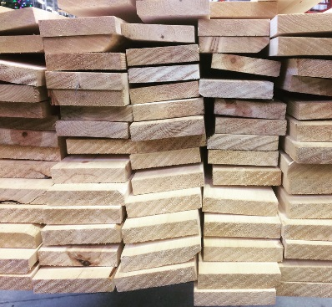
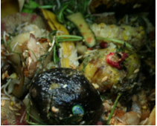
Most Important Materials to Recycle and Compost:
Carpet
Core Recyclables
Aluminum & Steel Cans
PET & HDPE Plastics
Cardboard & Paper
Dimensional Lumber
Food Scraps
Recycling & Composting Key Materials 1
Source: EPA Report: Reducing Greenhouse Gas Emissions through Recycling and Composting, 2011

Slide 15
Thousands of Tons
Recycling vs. Total Waste Generated 1
Source: EPA Report: Advancing Sustainable Materials Management: Facts and Figures, 2014

Slide 16
2006 U.S. GHG inventory
with 32% recovery
(municipal solid waste)
2006 U.S. GHG inventory with
hypothetical recovery rate
(~100% municipal solid waste + construction and demolition debris)
Limits of Recycling and Composting1

Slide 17
Relative Greenhouse Gas Emissions of Water Consumption Options
Plastic bottle, recycled
Reuse Reduces GHG Emissions1
Source: A study commissioned by Oregon Dept of Environmental Quality

Slide 18
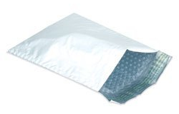
Reduction is Best t
Source: A study commissioned by Oregon Dept of Environmental Quality

Slide 19
Food Waste Management Activities
Reduction is Best t
Source: A study commissioned by Oregon Dept of Environmental Quality

Slide 20
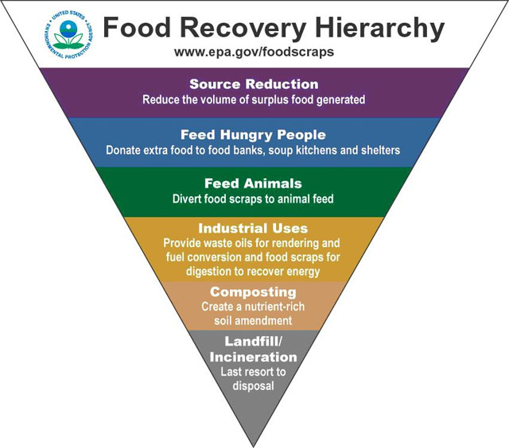
Toolkit tools:
Get Smart: See how much food (& money) you’re throwing away
Smart Shopping: Buy what you need
Smart Storage: Keep fruits and vegetables fresh
Smart Prep: Prep now, eat later
Smart Saving: Eat what you buy
Reducing wasted food can save a family of four about $1600 a year!
Food: Too Good to Waste t

Slide 21
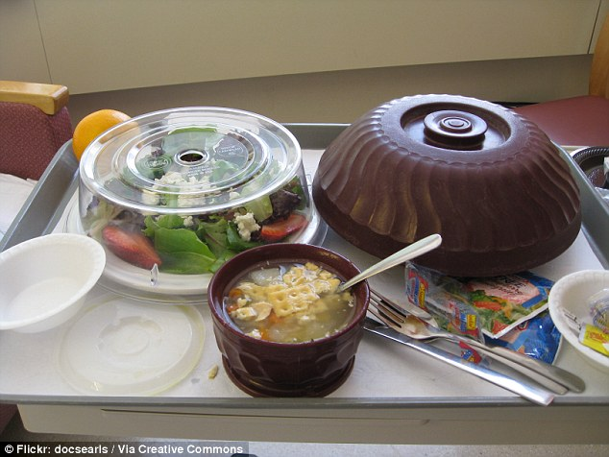
Results: 50% waste reduction; $25,000 cost savings
Case Study: Hospital Food Service 1

Slide 22
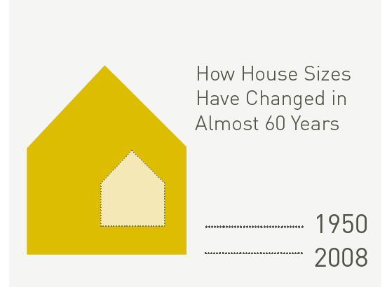
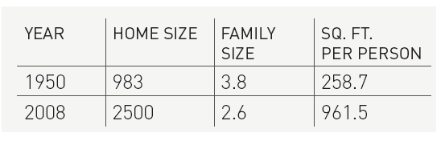
Reducing Building Materials t
Source: Oregon DEQ, Cascadia GBC

Slide 23
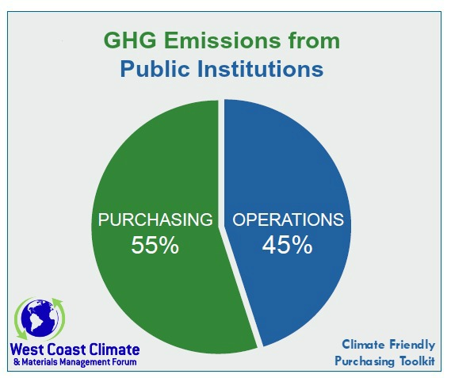
Our purchases have big greenhouse gas impacts.
These can be reduced by wise purchasing decisions
Climate Friendly Purchasing t

Slide 24
Climate Friendly Purchasing Toolkit Modules
Fuels
Information & Communications Technology
Professional Services
Asphalt
Concrete
Food
Climate Friendly Purchasing t

Slide 25
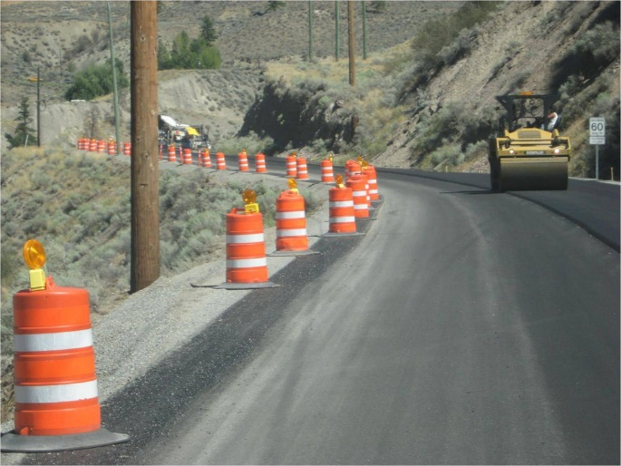
Results: ~15% energy reduction; 8,700 MTCO2e reduction
Case Study: Warm-Mix Asphalt 1

Slide 26
Results: 50% energy reduction; $685,000 cost savings
Case Study: Managed Print Services1

Slide 27
Reduce Consumption1
Photo credit: flickr user jesusali, licensed under Creative Commons Attribution-Non-Commercial 2.0 license

Slide 28
Changing Consumption Patterns1

Slide 29
A materials management toolkit of:
Climate Protection Actions
Example Climate Action Plans
New Approaches to GHG Inventories
Measurement Tools
Links to resources
And more...!
https://westcoastclimateforum.com/toolkit/homepage
Climate Action Toolkit 1

Slide 30
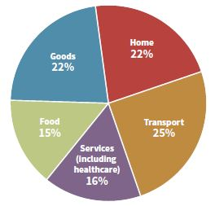
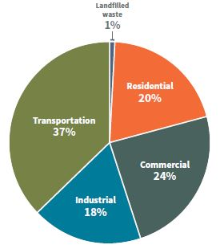
~ City of Portland ~
Traditional Sector- Based Inventory
Consumption-Based Inventory
7.7 MMTCO2e
17.1 MMTCO2e
Consumption-Climate Connection !

Slide 31
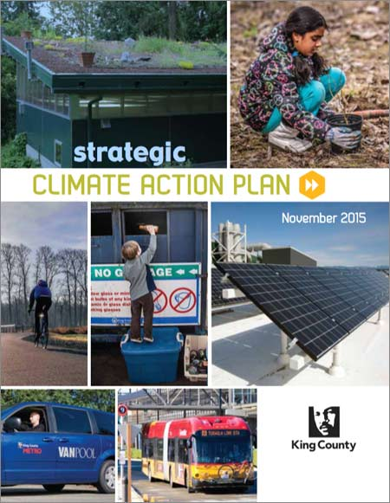
Local Climate Action Plans1

Slide 32
Materials and Greenhouse Gas Emissions
Strategies to reduce material-related greenhouse gas for governments and others
Recycling
Reusing and Reducing
Climate Friendly Purchasing
Consuming Less
Climate Action Plans
Case Studies
Resource
Summary y

Slide 33
Name
Email
Phone
We welcome your feedback and ideas .

Slide 34
https//westcoastclimateforum.com
https://westcoastclimateforum.com 1

Slide 35
